Slide 1
Signals and System
Dr. Wazir Muhammad Laghari
Electrical Engineering Department
BUET, Khuzdar

Slide 2
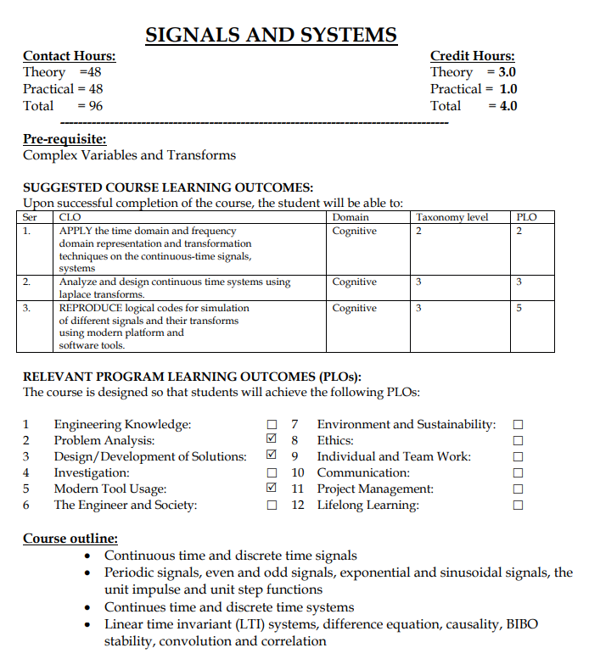
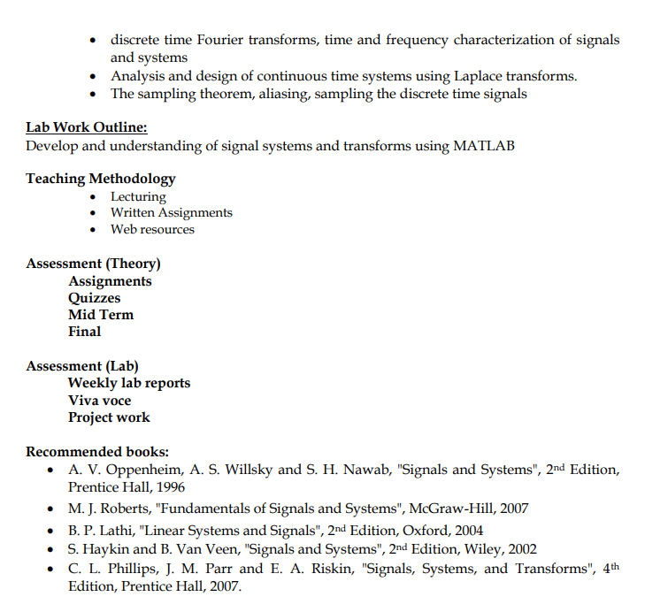

Slide 3
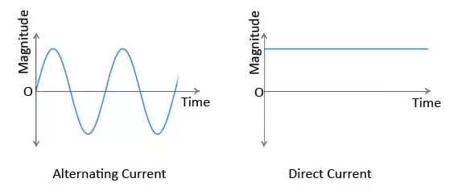
Signal
Signal is a dependent of function of one or more independent variable.
Signal is a function of independent variable
F (x₁ , x₂ , . . . x_{n})
Signal Not a Signal
Independent variables
Signal

Slide 4
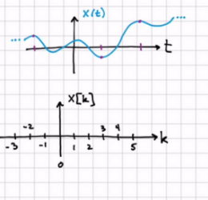
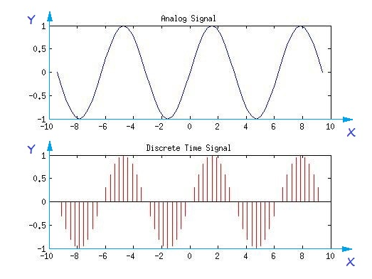
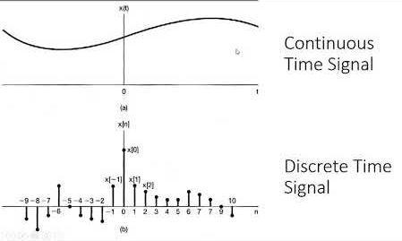
Continuous Versus Discrete Time Signal

Slide 5
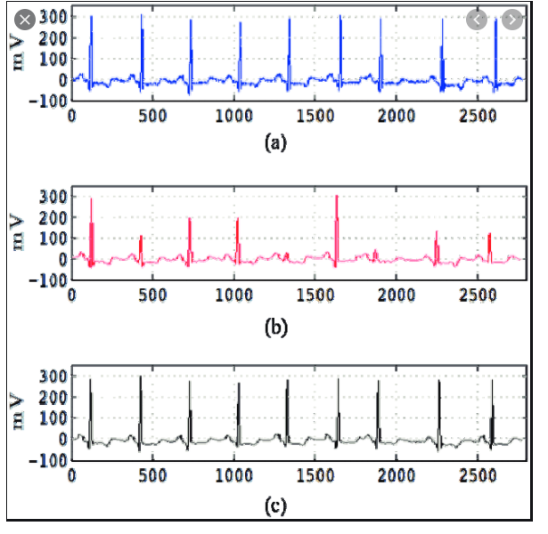
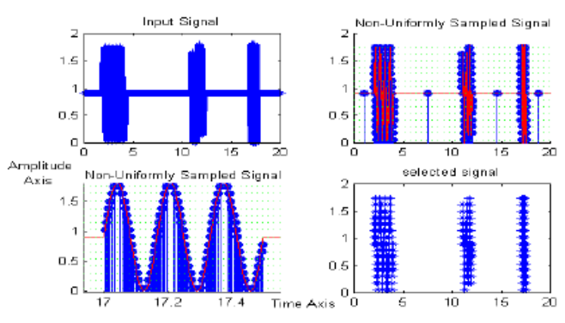
Uniformly And Non-Uniformly Sampled Signal

Slide 6
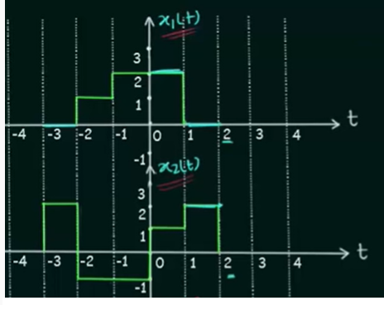
Addition of Continuous-Time Signals

Slide 7
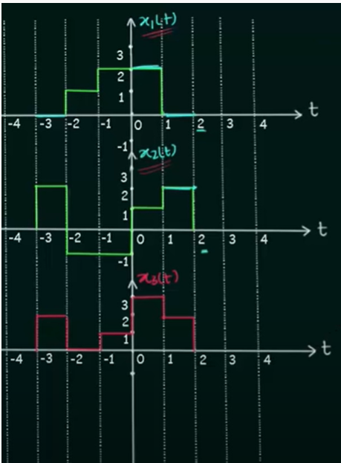
Addition of Continuous-Time Signals

Slide 8
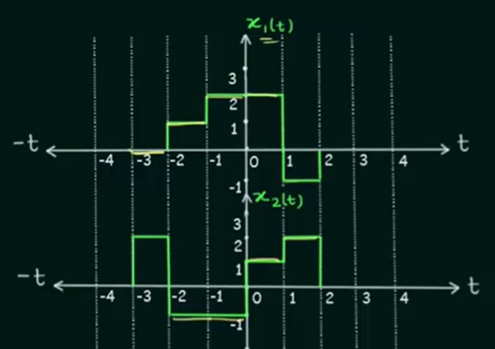
Multiplication of Continuous-Time Signals

Slide 9
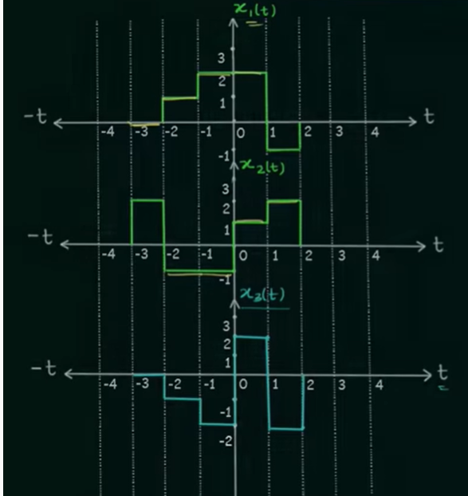
Multiplication of Continuous-Time Signals

Slide 10
Time Scaling of Continuous-Time Signals
Speed up or slow down a signal • Multiply the time in the argument by a constant

Slide 11
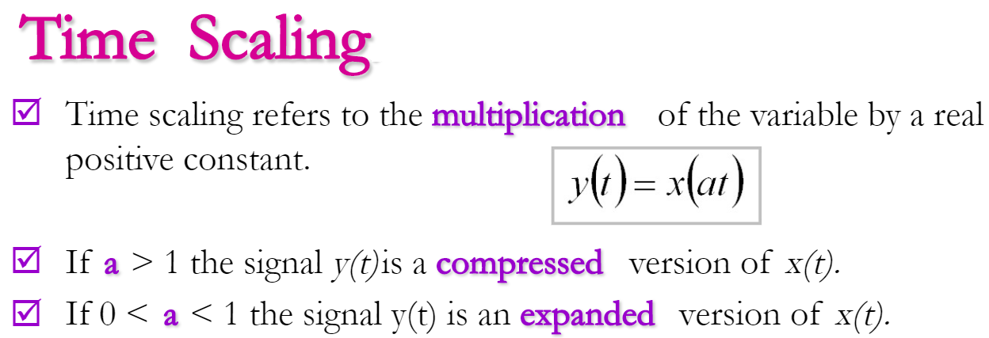
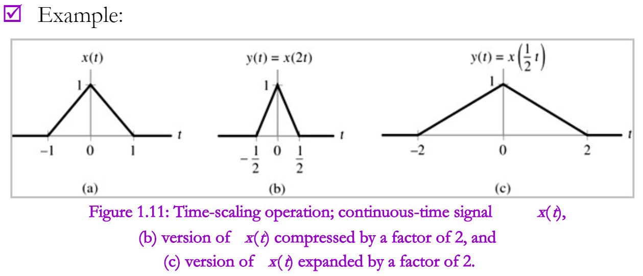
Speed up or slow down a signal.
Multiply the time in the argument by a constant

Slide 12
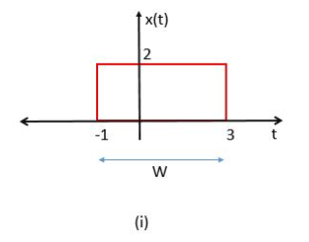
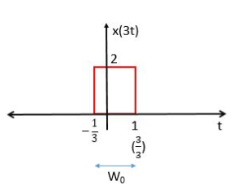
Q: Find x(3t)
$$3t=−1$$
$$t=−\frac{1}{3}$$
$$And$$
$$3t=3$$
$$t=\frac{3}{3}=1$$
Time Compression

Slide 13
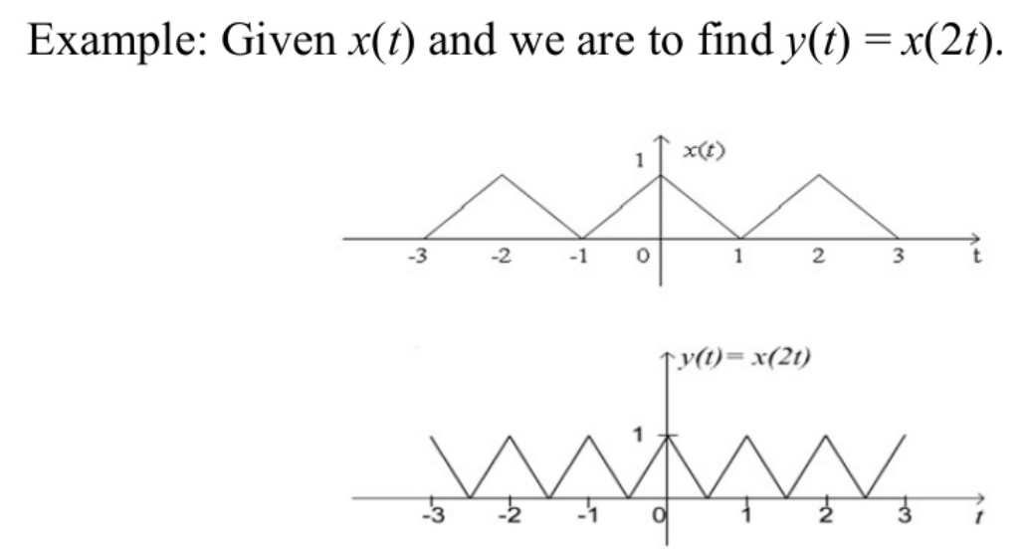
Time Scaling Compression

Slide 14
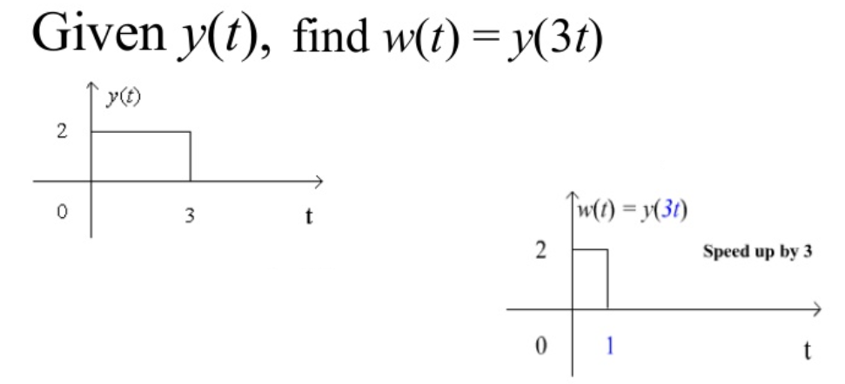
Time Scaling Expansion

Slide 15
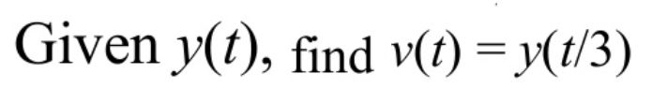
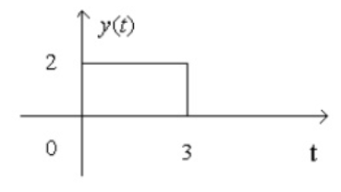
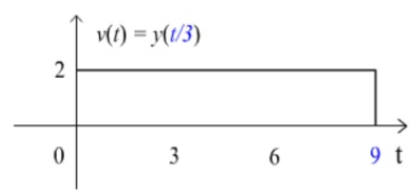
$$\frac{t}{3}=0$$
$$t=0$$
$$And$$
$$\frac{t}{3}=3$$
$$t=9$$

Slide 16
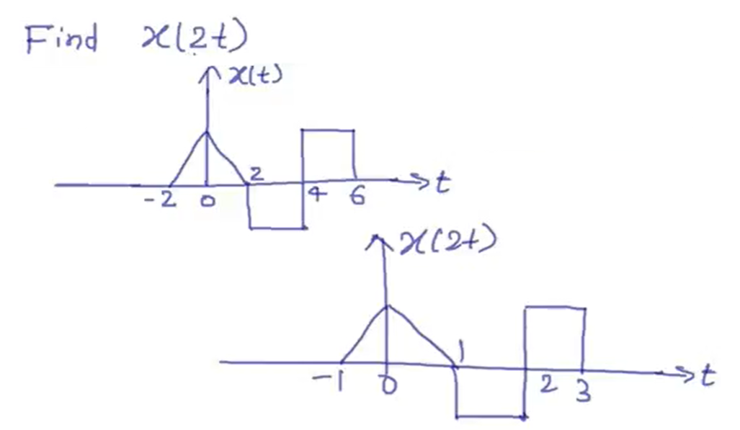
$$2t=−2$$
$$t=−1,$$
$$2t=0$$
$$t=0,$$
$$2t=2$$
$$t=1,$$
$$2t=4$$
$$t=2,$$
$$2t=6$$
$$t=3$$
Solution

Slide 17
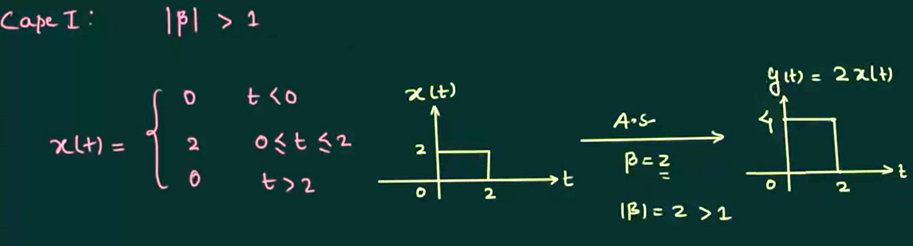
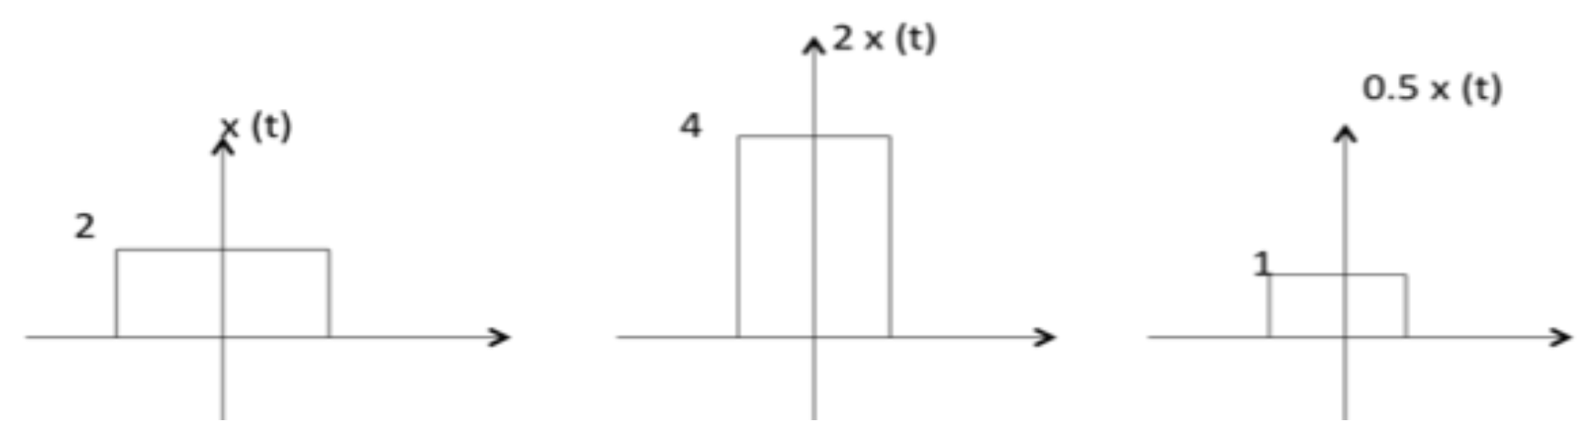
Amplitude Scaling of Continuous-Time Signals
Amplification
Multiply the entire signal by a constant value
OR

Slide 18
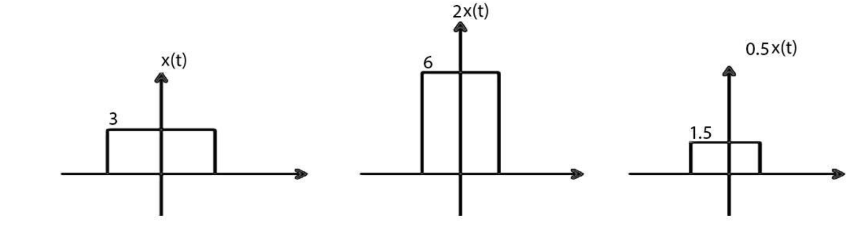
Amplitude Scaling of Continuous-Time Signals
Amplification Reduction

Slide 19
Shifting of Continuous-Time Signals
Shifting means shift the signal position to left or right is called Shifting.
Shifting is the two types:
Time Shifting
Amplitude Shifting

Slide 20
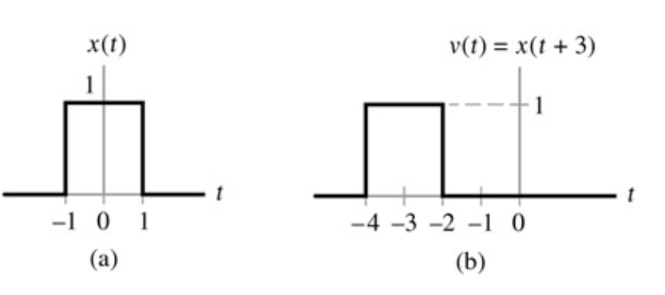
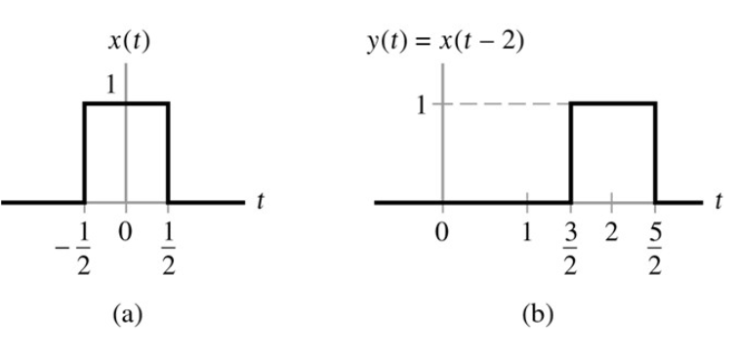
Time Shifting of Continuous-Time Signals
Left Shifting OR
Time Advance
Right Shifting OR
Time Delay
$$t −2=0 ↔t=2,$$
$Now on x−axis −\frac{1}{2}+2=\frac{3}{2}, 0+2=2$, $\frac{1}{2}+2=\frac{5}{2}$
$$t+3=0 ↔t=−3,$$
$Now on x−axis −1−3=−4, 0−3=−3$, $1−3=−2$

Slide 21
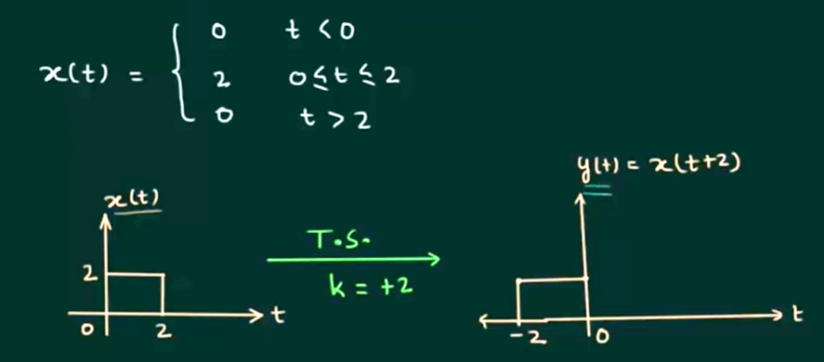
Time Shifting of Continuous-Time Signals

Slide 22
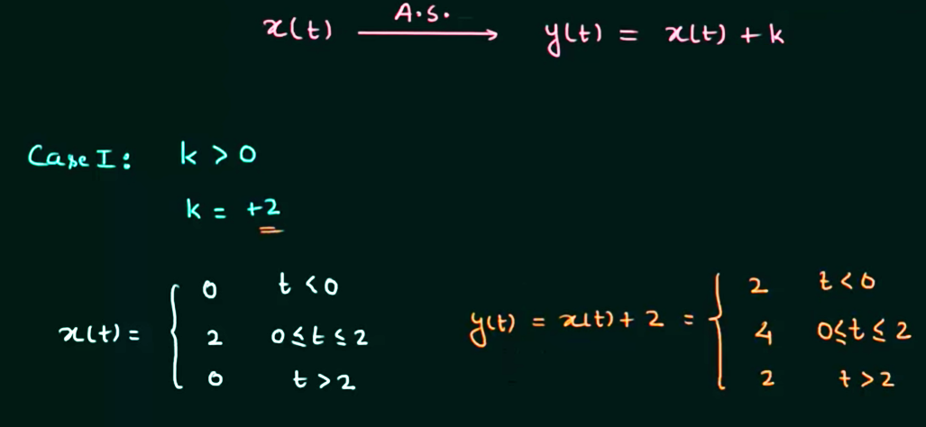
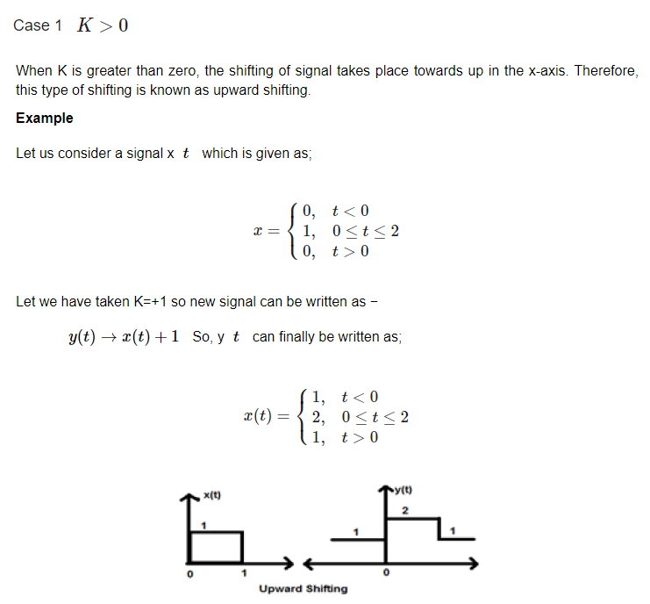
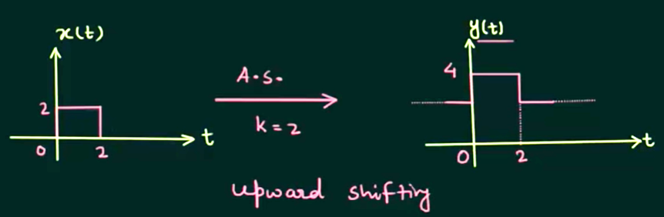
Amplitude Shifting of Continuous-Time Signals

Slide 23
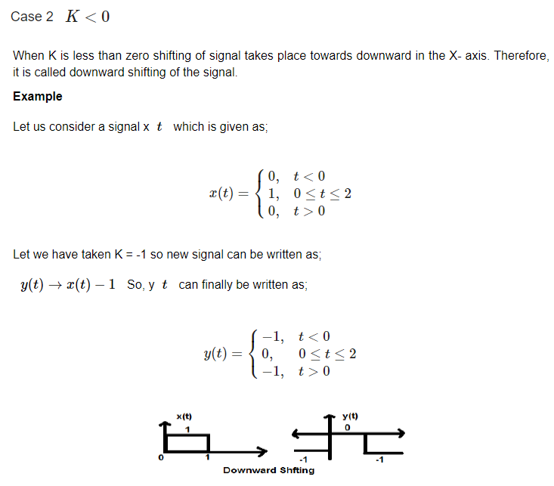

Slide 24
Reversal of Continuous-Time Signals
Whenever the time in a signal gets multiplied by -1, the signal gets reversed.
It produces its mirror image about Y or X-axis. This is known as Reversal of the signal.
Reversal can be classified into two types based on the condition whether the time or the amplitude of the signal is multiplied by -1

Slide 25
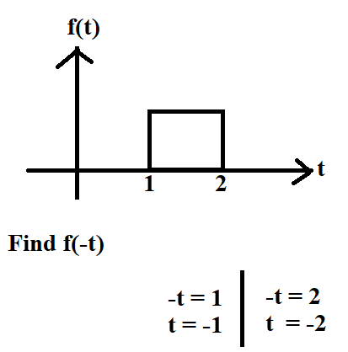
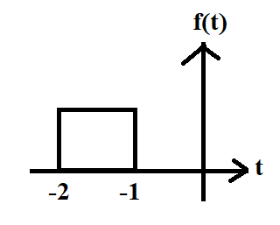
Reversal of Continuous-Time Signals Case-1: Time Reversal

Slide 26
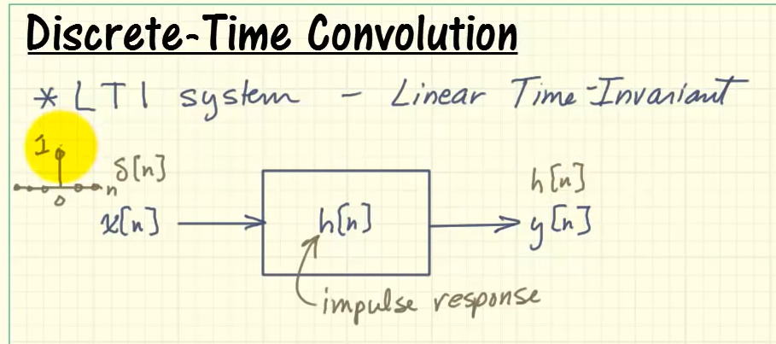
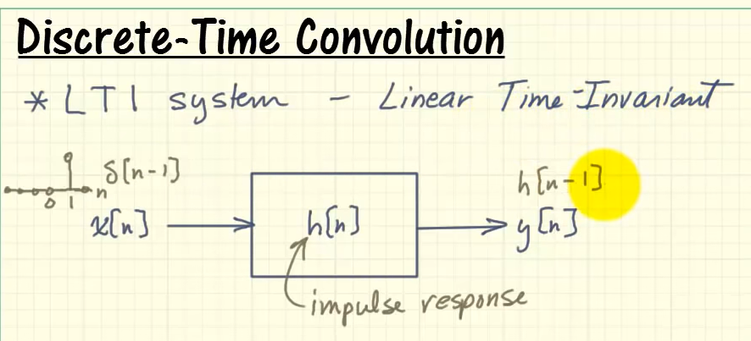

Slide 27
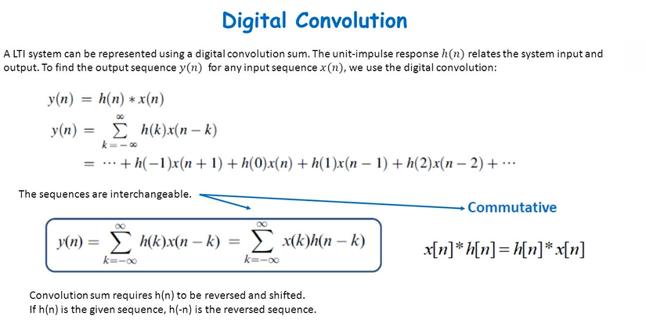
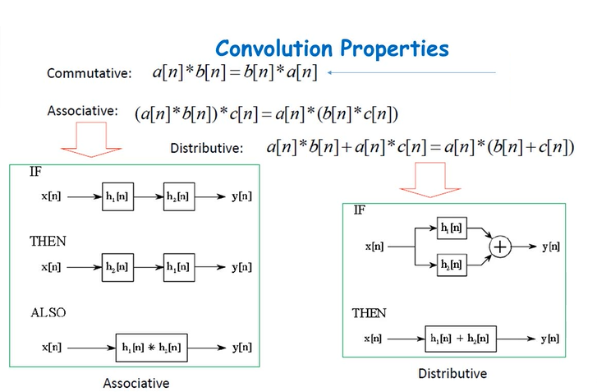

Slide 28
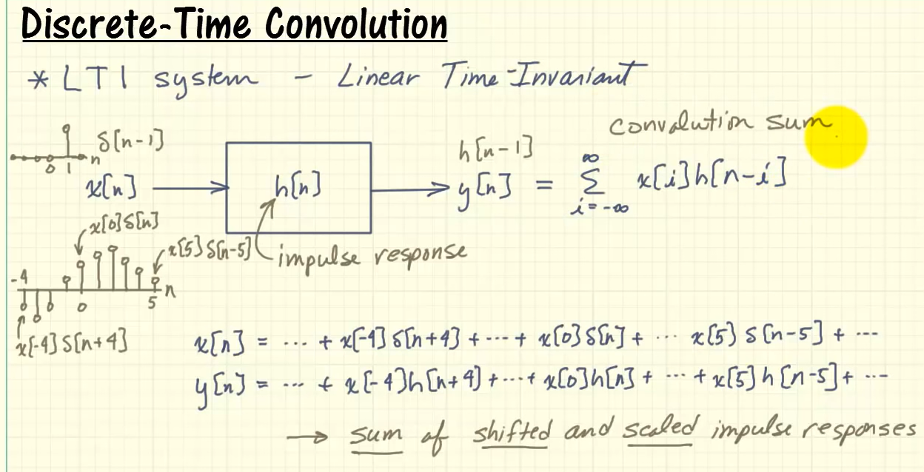

Slide 29
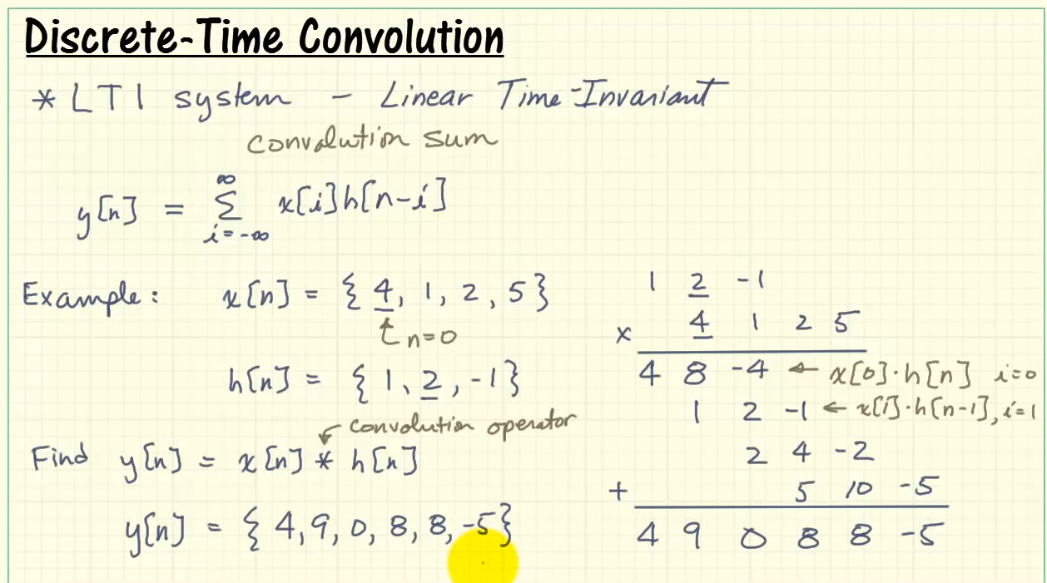
Q: Find the convolution, if x(n) = {4,1,2,5} and h(n) = {1,2,-1}

Slide 30
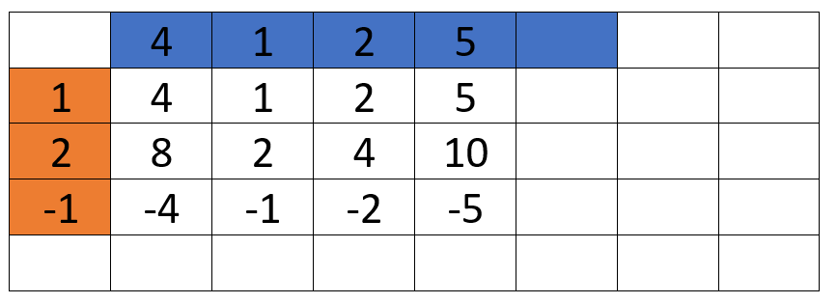
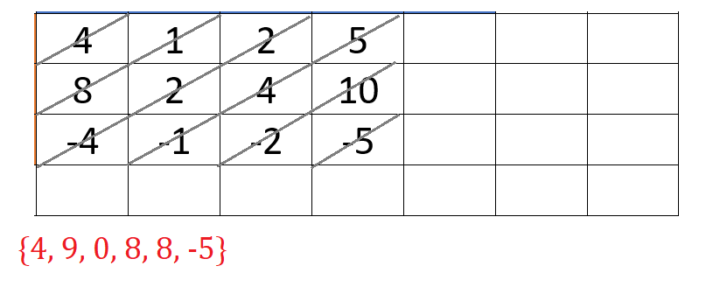
Q: Find the convolution, if x(n) = {4,1,2,5} and h(n) = {1,2,-1}

Slide 31
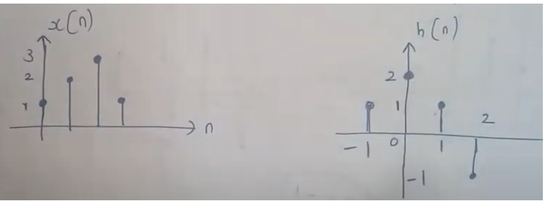
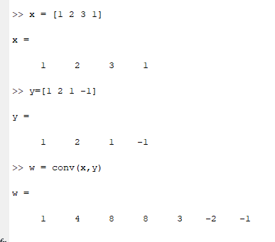
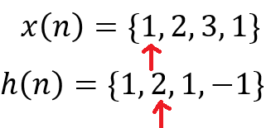
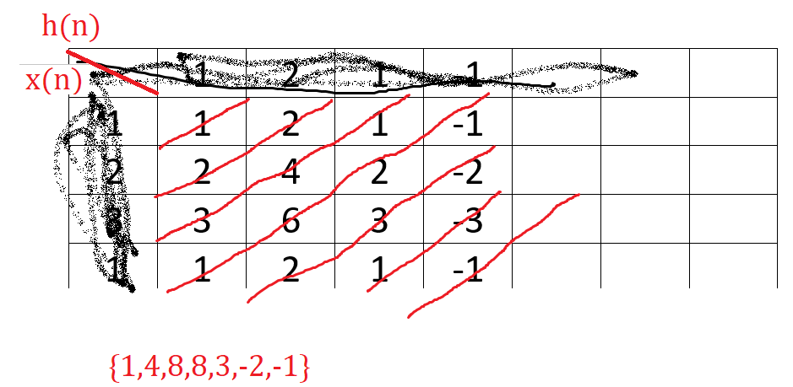
Q: Determine the response of LTI System whose input x(n) and impulse response h(n) are given by
Length = m+n-1=4+4-1=7

Slide 32
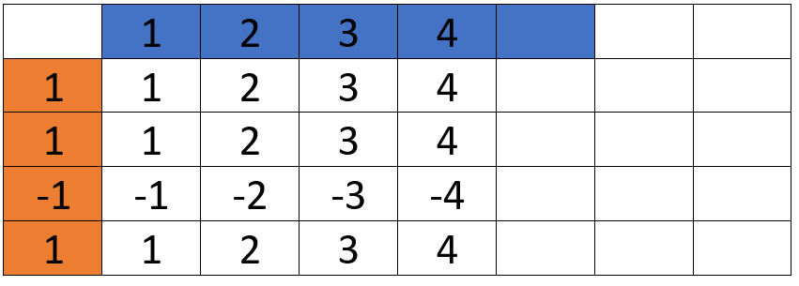
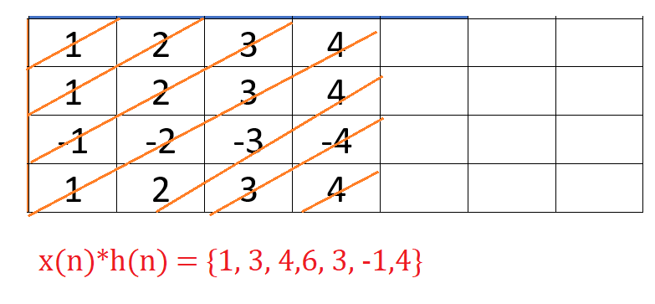

Slide 36
Q: Find the convolution, if x(n) = {4,1,2,5} and h(n) = {1,2,-1}

Slide 37
Q: Find the convolution, if x(n) = {4,1,2,5} and h(n) = {1,2,-1}

Slide 38
Q: Determine the response of LTI System whose input x(n) and impulse response h(n) are given by
Length = m+n-1=4+4-1=7

